Slide 1
Florida Department of Health
Pinellas County License Board
Emergency Regulations/State of Emergency
Hurricanes Helene and Milton
November 13, 2024

Slide 2
Emergency Regulations / State of Emergency Hurricanes Helene and Milton
Faith Bornoff M.Ed.
Executive Director
Florida Department of Health in Pinellas County
Pinellas County License Board (PCLB)

Slide 3
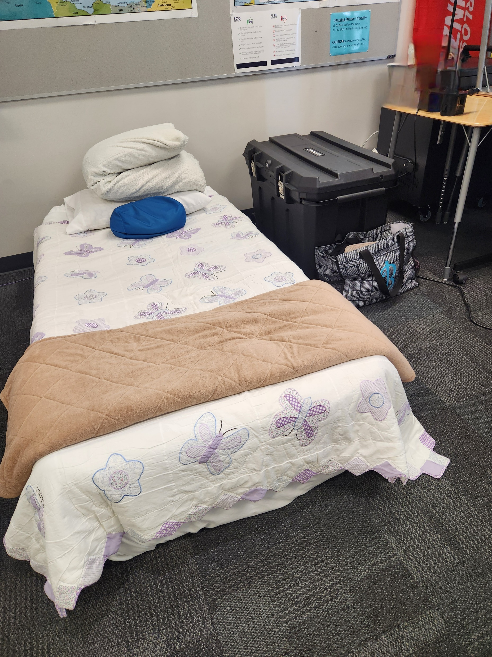
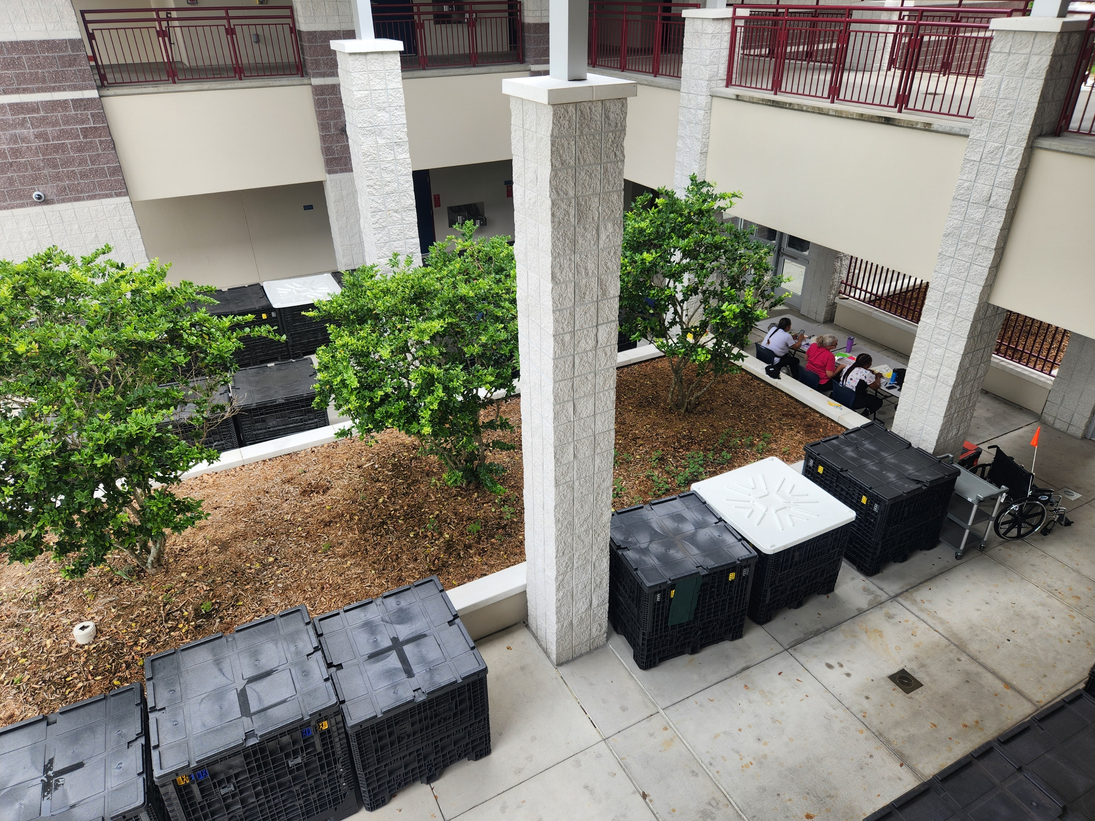
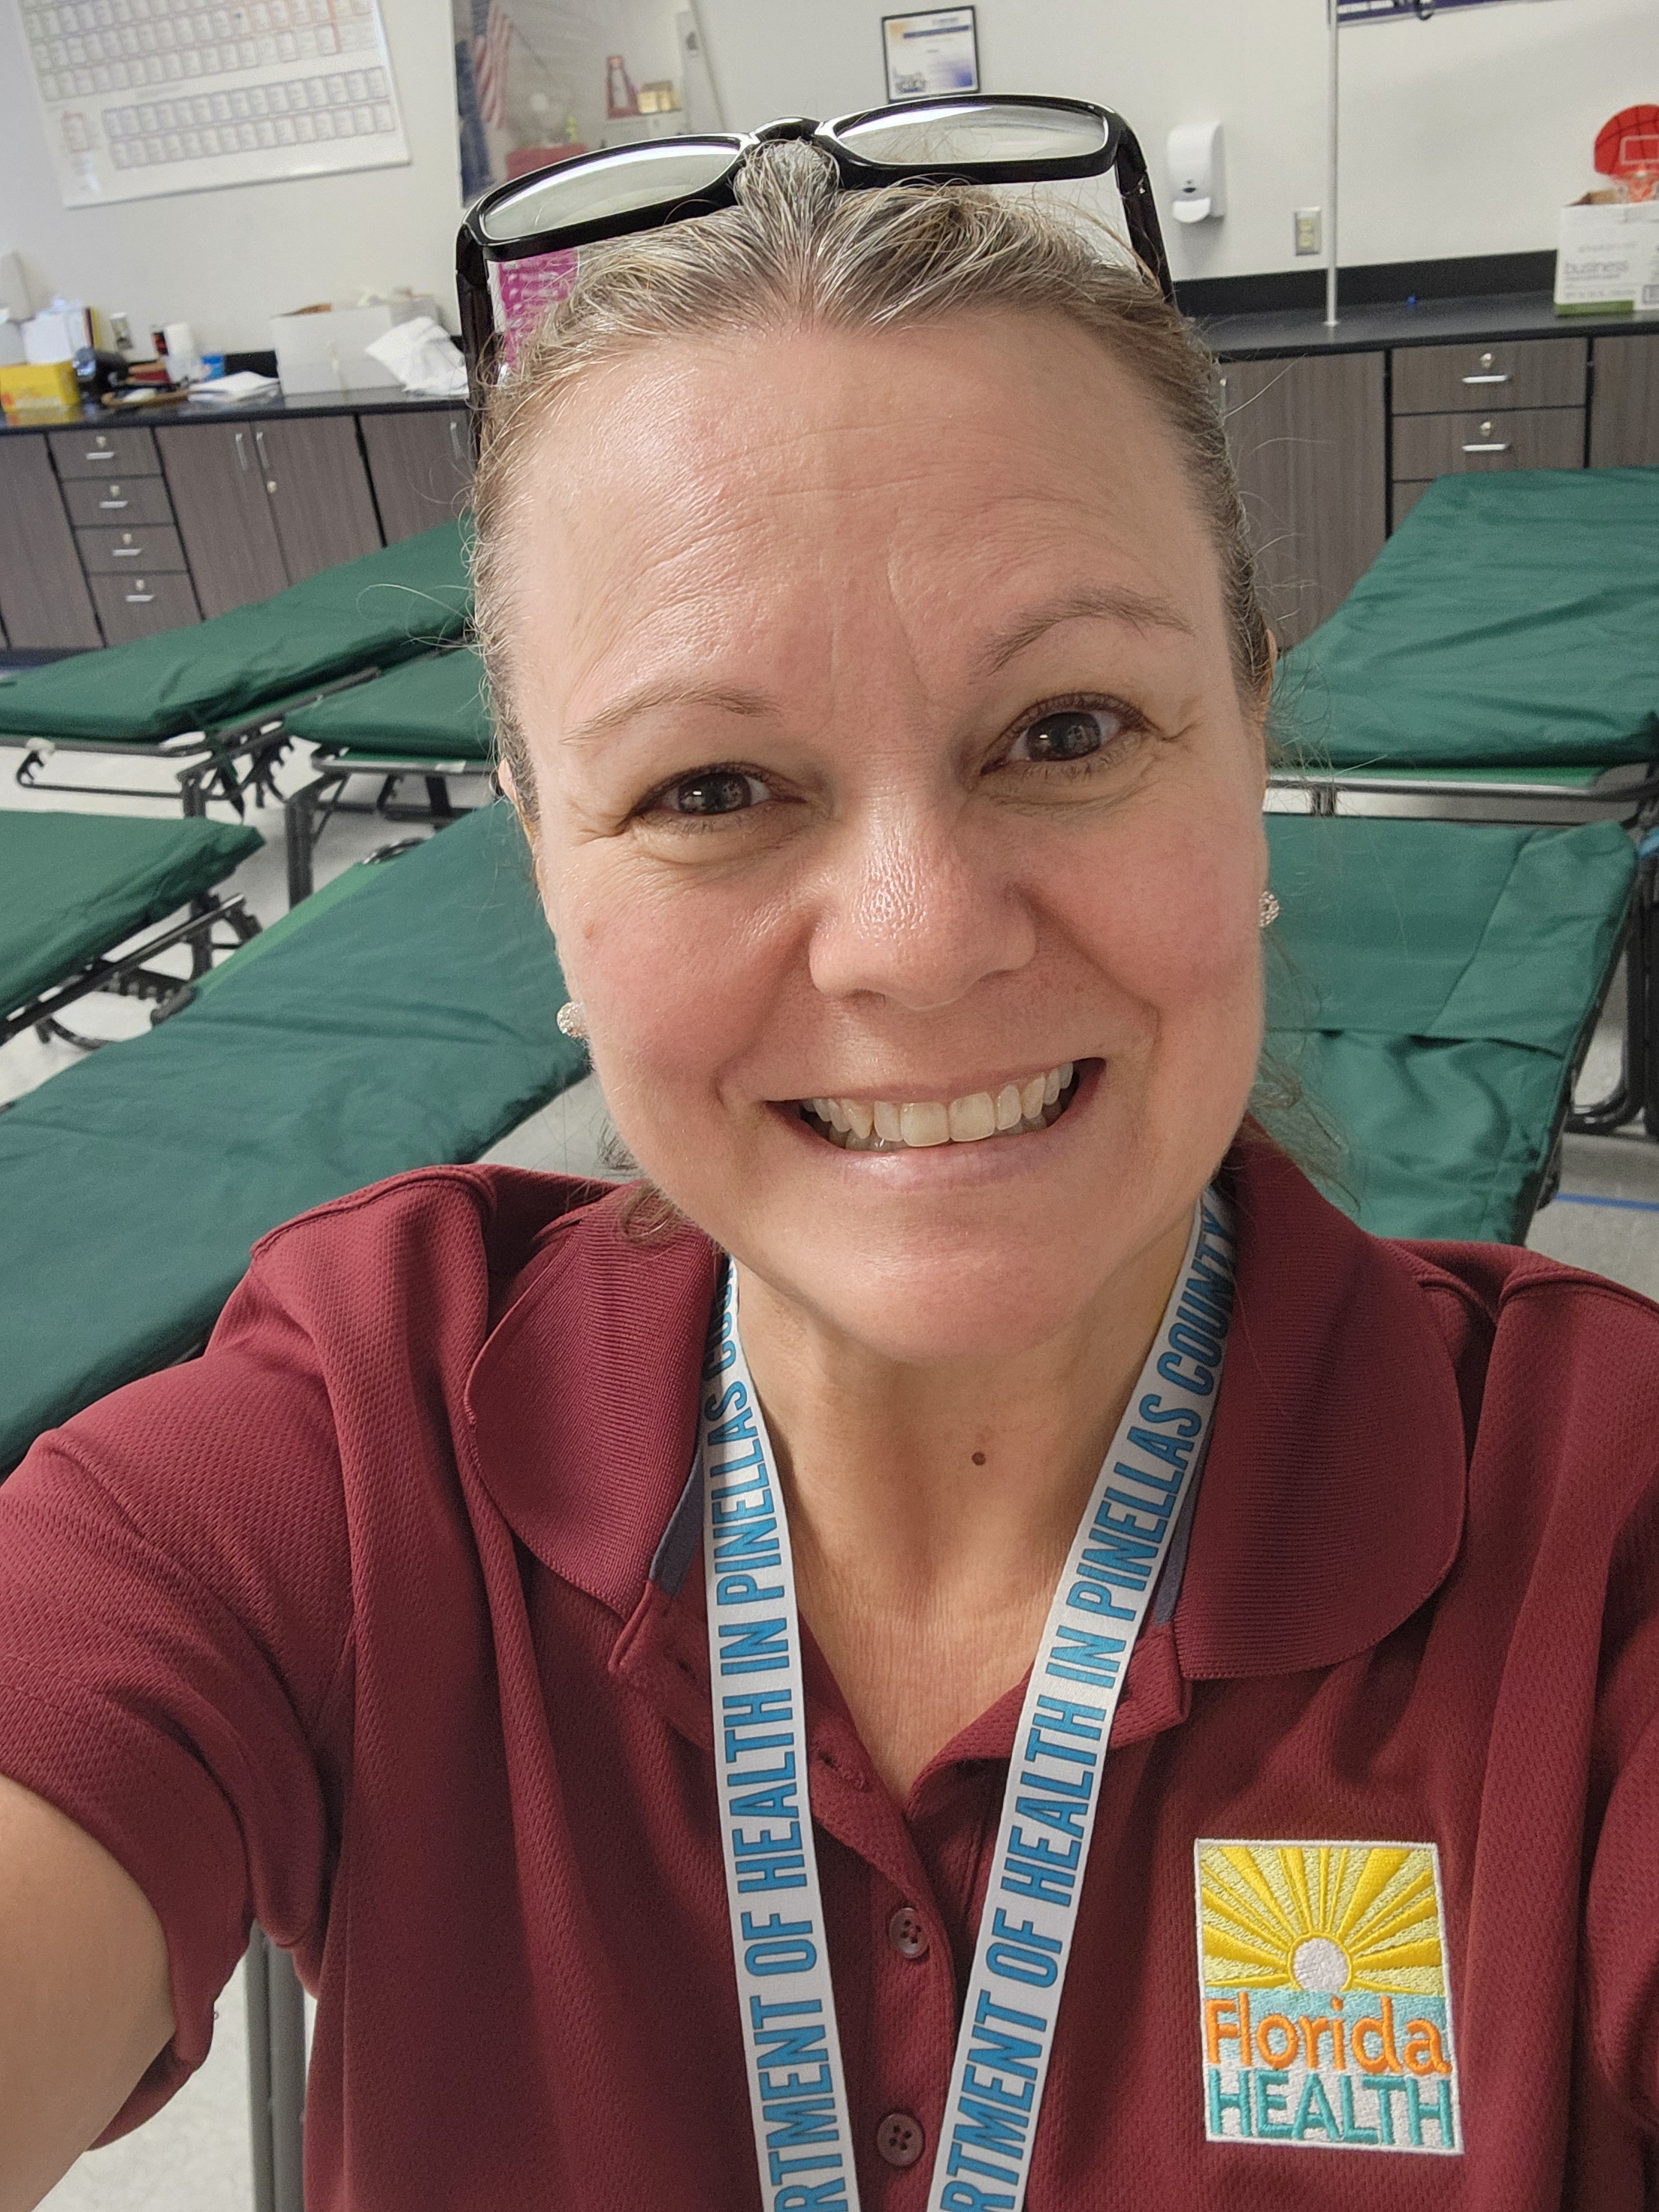
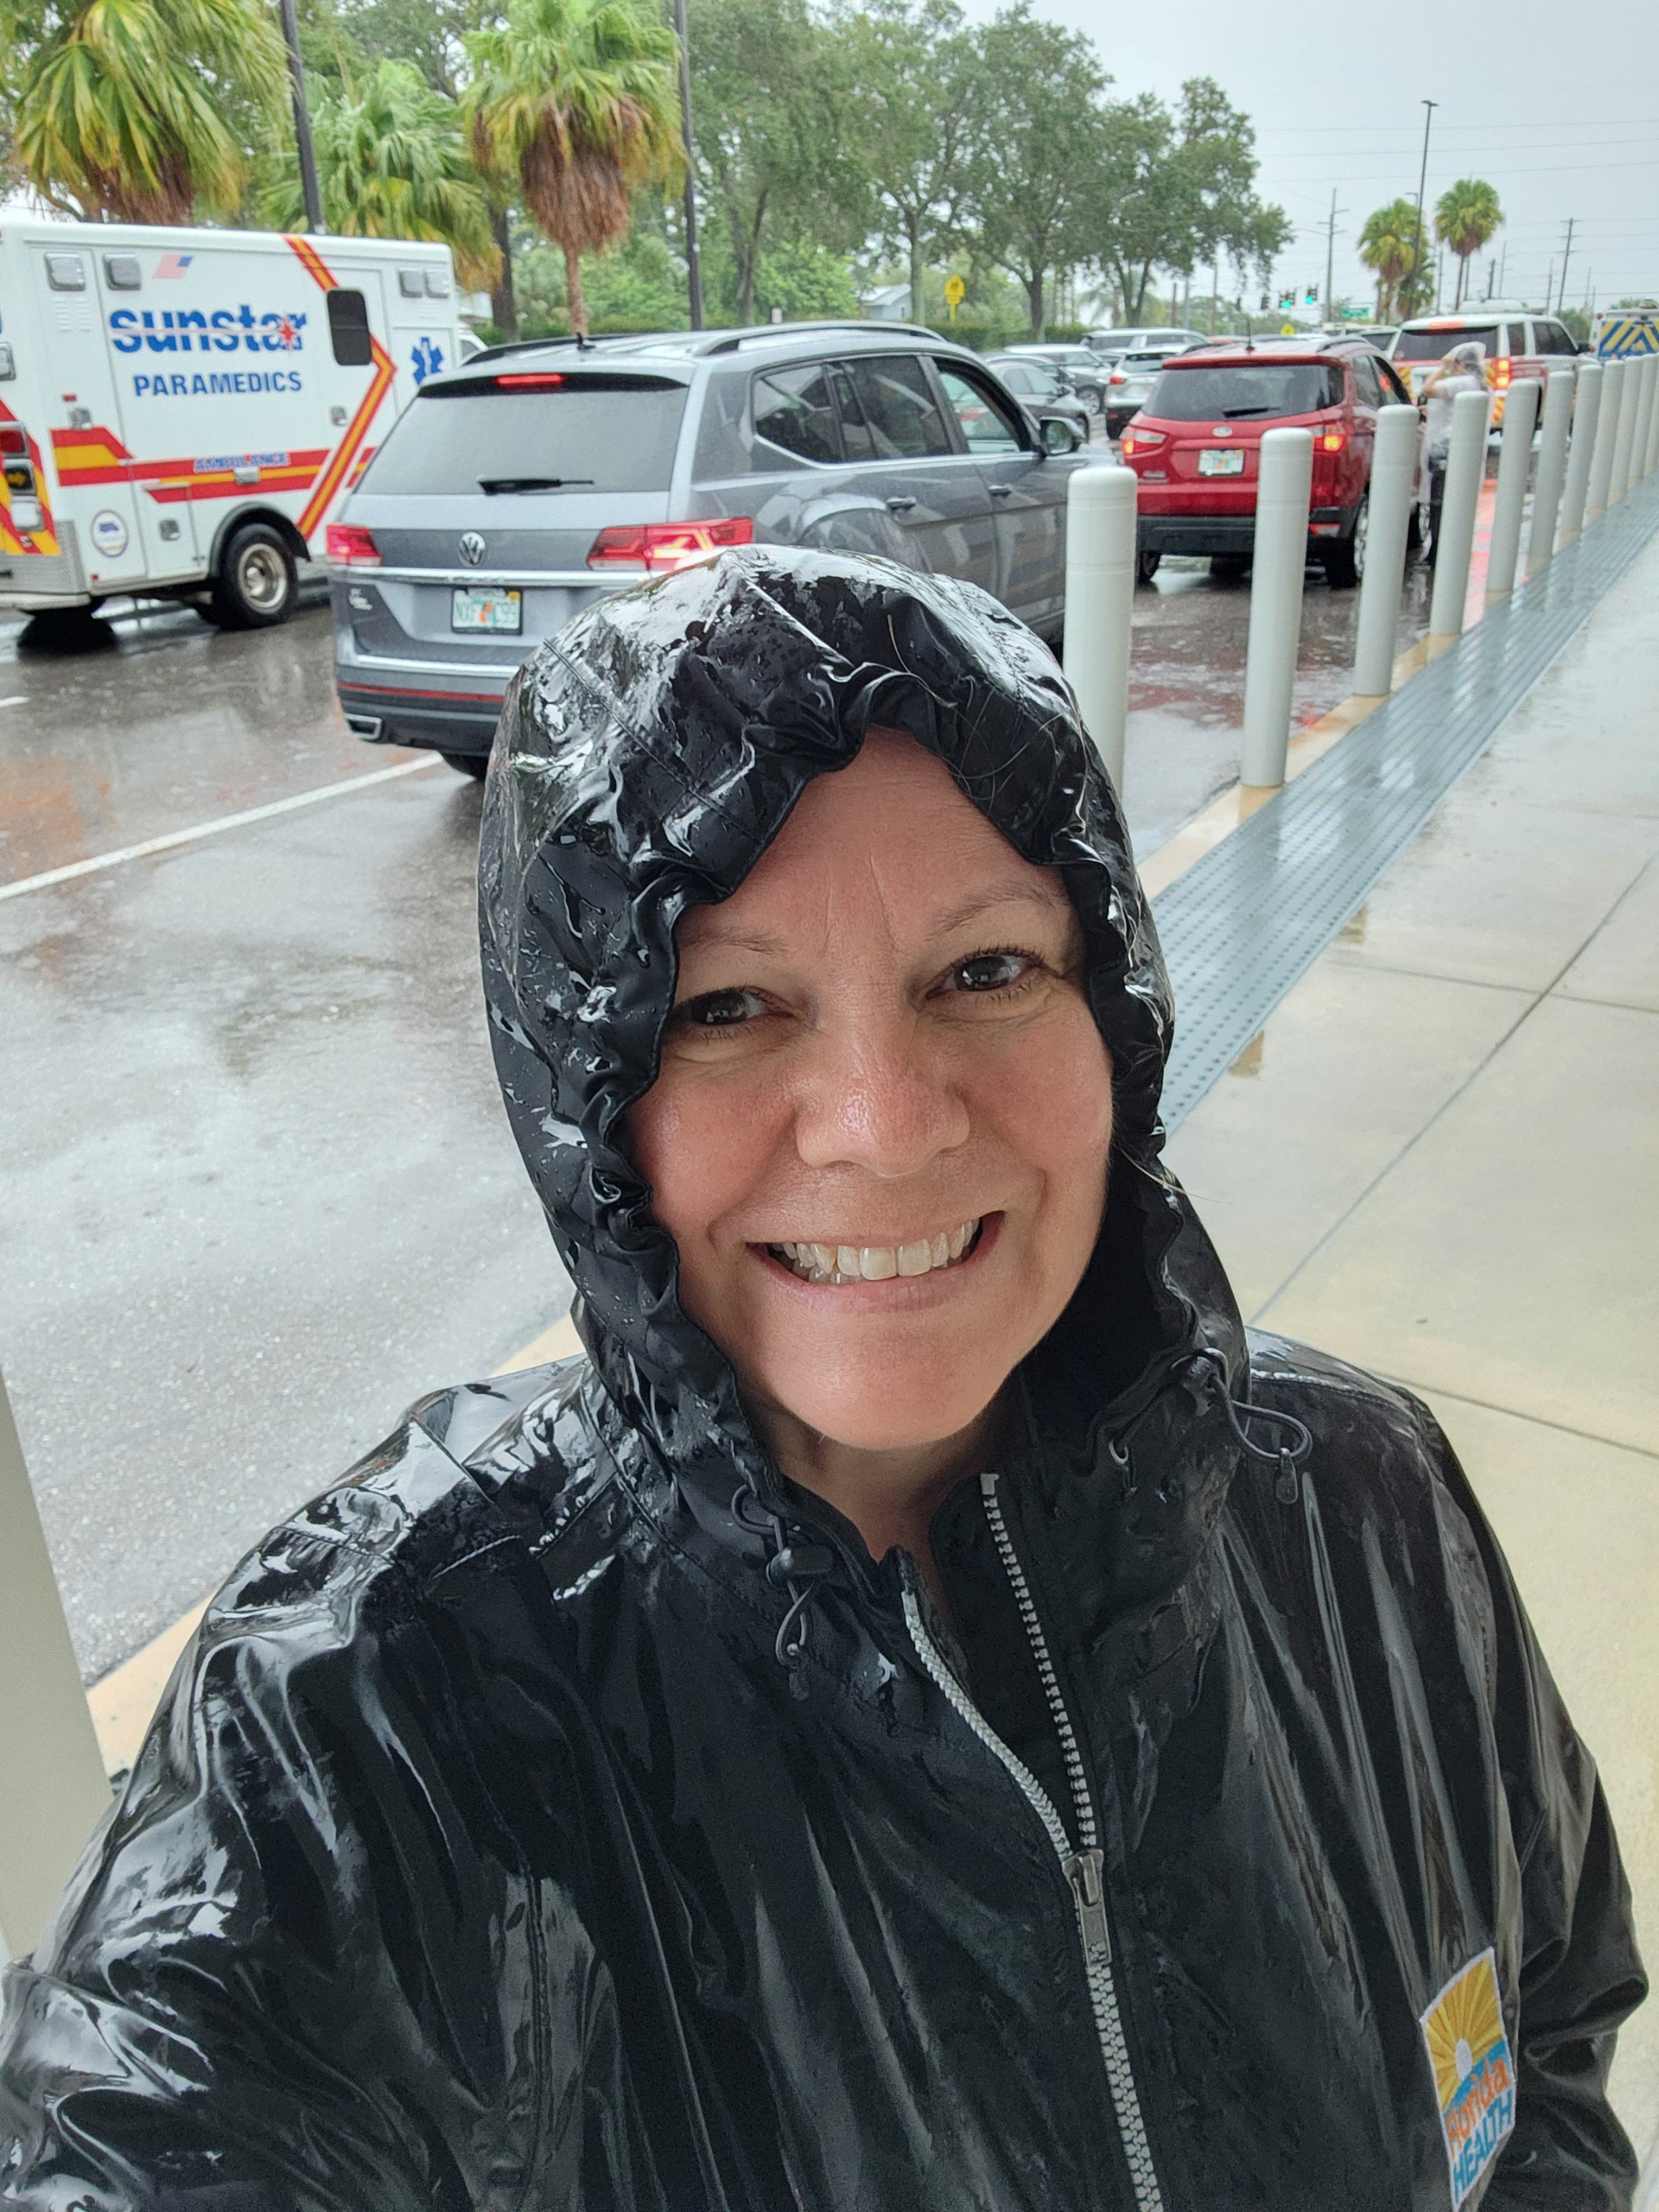
Emergency Regulations / State of Emergency Hurricanes Helene and Milton
As Department of Health (DOH) Employees, Pinellas County License Board (PCLB) Staff are required to serve in Special Needs Shelters.
Notes:
As a reminder:
PCLB staff work at local Special Needs Shelters.
We have 17 PCLB staff.
1- works at shelter every storm (me)
13- work every other storm
(and 3 work every storm as post storm personnel)

Slide 4
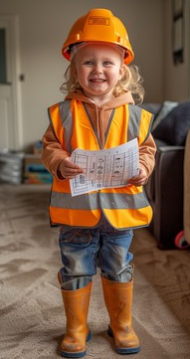
Emergency Regulations / State of Emergency Hurricanes Helene and Milton
To ensure the continuation of child care
operations throughout the county, three
PCLB staff have been assigned to assist
child care programs with issues that arise
following a weather-related event.
Post Storm Team:
1 Supervisor and 2 Licensing Specialists
Notes:
3 staff have been designated to work every storm as post storm personnel.
Duties:
Collect provider status
Reach out to providers that have not reported
Assess storm damages to re-open centers/homes
Report data to DCF and DOH

Slide 5
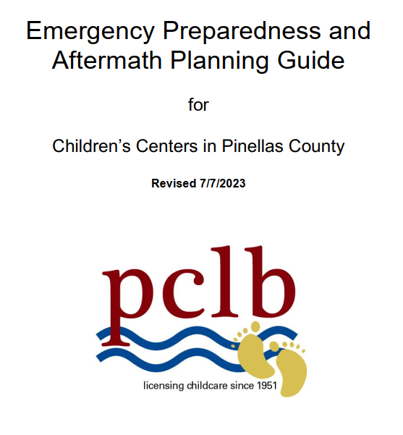
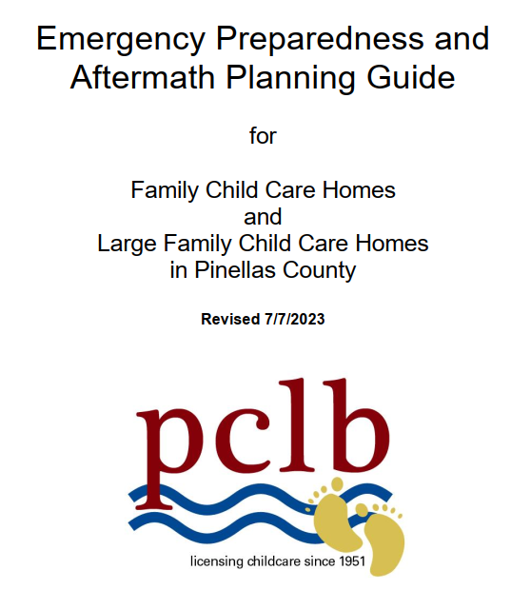
Emergency Regulations / State of Emergency Hurricanes Helene and Milton
An Emergency Preparation Guide that includes the Emergency Regulations are sent to all licensed Children’s Centers and Family Child Care Homes at the beginning of hurricane season, then again just before a storm event when possible.
Notes:
Sent out at beginning of hurricane season, and ahead of each storm when possible
Emergency phone number for storm reporting
Centers and homes are REQUIRED to report their status. It is a regulation.
Emergency regulations
Other helpful information

Slide 6
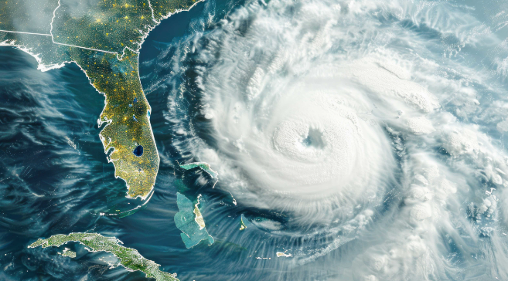
Emergency Regulations / State of Emergency Hurricanes Helene and Milton
Emergency Regulations are used when there is State of Emergency in Pinellas County that affects the normal operations of Children’s Centers and/or Family Child Care Homes.
Examples Include:
Broad Power or Utility Outages
Terrorist or Man-Made Events
Natural Disasters such as Tropical Storms or Hurricanes
Notes:
Emergency Regulations are specific to Pinellas County.
They reduce the regulations to DCF minimum standards for post storm operations during LOCAL STATE OF EMERGENCY.

Slide 7
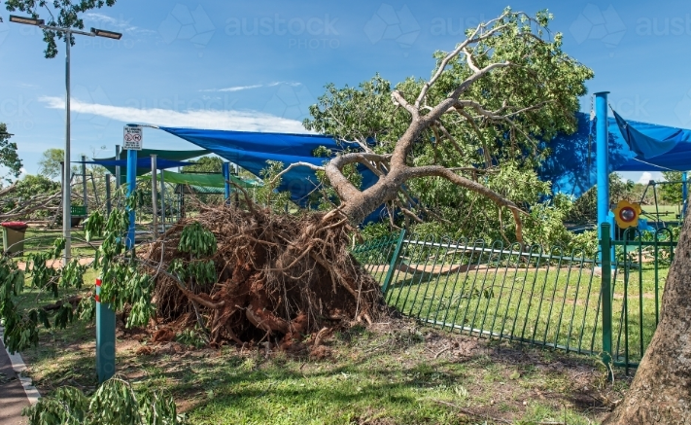
Emergency Regulations / State of Emergency Hurricanes Helene and Milton
Once the local Pinellas County State of Emergency has ceased, the PCLB Executive Director can choose to allow an extension of the Emergency Regulations on a case-by-case basis to continue safe operations of Children’s Centers and Homes.
Notes:
Centers and Homes may continue use of emergency regs after local state of emergency with PCLB Executive Director permission.
Center and homes are neglecting to request the use of emergency regulations to be extended.

Slide 8
Emergency Regulations / State of Emergency Hurricanes Helene and Milton
In the event a Children’s Center is unable to use their current licensed space due to damage, an extended field trip plan may be implemented. This allows programs to use an alternate location under the same license number.
Benefit:
No additional license processing time or fees incurred
Keeps funding streams in place for programs and families
No need to seek student transfers from the Early Learning Coalition (ELC)
Notes:
This saves time and money for us, centers, homes, and ELC.

Slide 9
Emergency Regulations / State of Emergency Hurricanes Helene and Milton
Current Status
Children’s Centers
17 Total Closed:
1 - Drop-in or as-needed status
1 - Closed permanently
5 - Relocated to other sites
10 - Permanent field trips
Multiple sites- playground closures
Family Child Care Homes
7 - Closed temporarily
0 - Closed permanently
Multiple sites- playground closures
Notes:
Drop-in center is as needed- not permanent enrollment
Centers relocated to other sites and permanent field trips anticipate going back to their former location at some point.
We are still assessing damages to playgrounds and fencing.

Slide 10
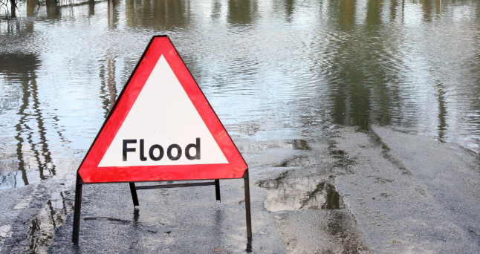
Emergency Regulations / State of Emergency Hurricanes Helene and Milton
PCLB Post Storm Update:
The DOH Mid-County Building sustained damage that caused it to be closed one day longer than other DOH buildings in Pinellas.
3 staff had flood damage to their homes.
DOH granted additional emergency
time off to those employees who had damage to their homes.
Notes:
All DOH offices have generators.
Network was down. Badge system would not work.
Staff who are not at a shelter, and are designated as post storm, cannot work until DOH re-opens.
Once our office re-opens, all staff help with post storm.

Slide 11
Emergency Regulations / State of Emergency Hurricanes Helene and Milton
Lessons Learned:
We need to collect emergency contact and phone number for children’s centers in the event the building is closed.
Due to lack of power and internet connections, providers were not able to contact PCLB which affected our ability to report status to DCF and DOH.
Not all providers reported their status or the need to continue the use of emergency regulations after they ceased.
Phone lines with voice mail service was cumbersome and not an efficient way to collect necessary data from providers.
Providers will still call and / or email their licensing specialists instead of calling the emergency number.

Slide 12
Emergency Regulations / State of Emergency Hurricanes Helene and Milton
After this Hurricane Season is over on November 30th, PCLB Staff will revisit the Emergency Preparedness Plans focusing on:
The collection of emergency contacts for
centers in the event of closure.
More efficient ways for providers to report their
operational status to PCLB.
Ensuring the required communication from
providers through the proper channels to
include both short-term and long-term statuses.
A better way of tracking providers status for
recording purposes.
Notes:
Hurricane season is not over until November 30th
There is another storm, Sara out there.
We will begin meeting to prepare for 2025 Hurricane season after the holidays.

Slide 13
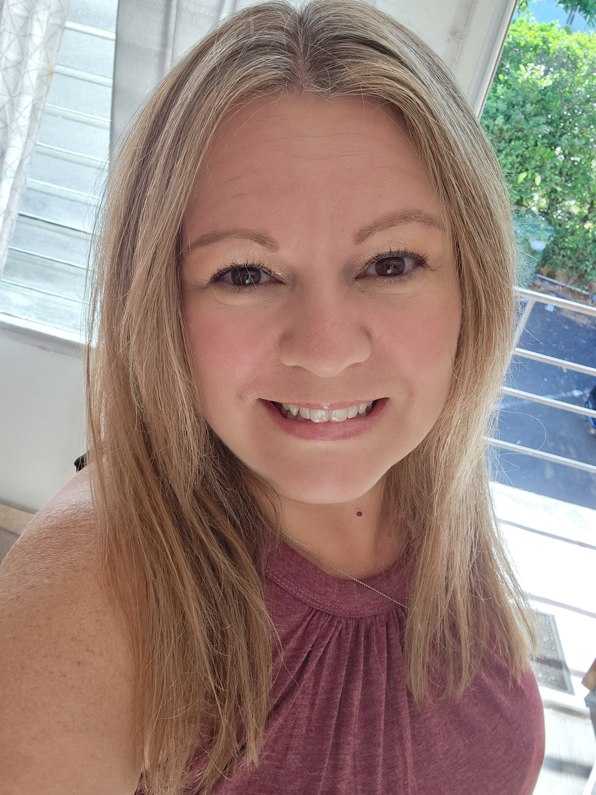
Contact Information
Faith Bornoff M.Ed.
Executive Director
Pinellas County License Board
Child Care Licensing
727-275-6451
faith.bornoff@flhealth.gov

